Slide 1
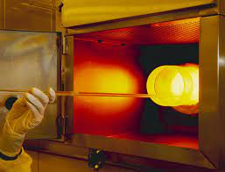
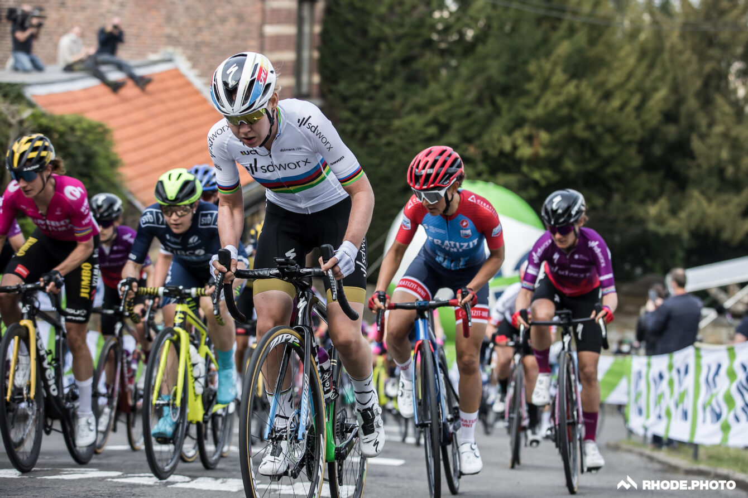

Hill climbing and simulated annealing for cipher solving
Dr Richard Bean
University of Queensland
COSC2500
Thursday 3 November 2022
https://cyclingtips.com/2021/04/its-time-to-rename-the-mur-de-huy-the-mur-de-van-der-breggen/
https://www.cs.bham.ac.uk/~minkull/slidesCISE/03-simulated-annealing.pdf
source

Slide 2
Classical Ciphers
Secure Communications
The message sender has a Plaintext (P), and a Key (K).
They send a Ciphertext (C) over some channel and the receiver uses the same Key (K) to recover P.
With the key and knowledge of how the cipher (algorithm) works we can transform the Plaintext into the Ciphertext, or vice versa.
Sometimes we express the transformation operation as addition.
For example, if the plaintext and key can be converted into bits (0s and 1s, ASCII) then the “Vernam cipher” just adds the (plain/cipher)text and the key (without carrying) to obtain the (cipher/plain)text.
P + K = C (using XOR exclusive-or operation)
A “classical cipher” means one invented and used before the modern computer age (perhaps end of WW2 to ~1970s)
“Cipher solving” refers to “cryptanalysis” or recovering K given only C.

Slide 3
Classical Ciphers
Caesar cipher
For each letter in a message, shift each message by a constant number of characters (1 to 25).
COMPUTER
DPNQVUFS
The well-known “ROT13” cipher shifts each letter 13 characters, so “enciphering” is the same operation as “deciphering”.
If an adversary suspects this cipher is in use, there are only 25 possibilities to check.
This cipher doesn’t change the frequency statistics of the message, so the frequency count of the letters
is likely to look like the source language, and more so the longer the message is.

Slide 4
Monoalphabetic substitution
What about instead of a simple rule, each letter goes to a different letter, perhaps based on a keyword?
Plaintext and ciphertext.
List the possible plaintext letters in order so we can find them easily.
PT ABCDEFGHIJKLMNOPQRSTUVWXYZ
CT COMPUTERABDFGHIJKLNQSVWXYZ
Then COMPUTER enciphers to MIGJSQUK.
How many possible mappings are there?
26! = 26 * 25 * 24 * … * 3 * 2 * 1 =
403,291,461,126,605,635,584,000,000 ~ 4 * 10²⁶ ~ 2⁸⁹ mappings!
If we are given ciphertext like MIGJSQUK …
How much ciphertext do we need to be confident we can recover the key or plaintext, without knowing the key?
Do we need to investigate all 26! possibilities to recover the key or plaintext?

Slide 5
Solving Monoalphabetic substitution ciphers
The first concept we need is a “score” or “likelihood function”.
(Assume the plaintext language is English to begin with).
Suppose we choose a key for a monoalphabetic substitution and part of the plaintext we get after applying the key
is “XYZZYX”.
Two ideas
Is this part of an English word?
Or, ignoring spaces, is this sequence of characters found often in English texts?
Clearly it’s not part of any common English word.
How many characters of this sequence do we need before we can state this is “unlikely” to be English text?
How do we quantify this likelihood to reach a “score”?

Slide 6

Scoring Text
The concept of the “n-gram”
Pick a value n (1 to 8)
Take a large corpus of English text (e.g. “Project Gutenberg” has about 60,000 books)
Consider only the characters which are A-Z (non-case-sensitive)
Develop a frequency count of the number of times each
Pick a non-zero “score” for a sequences that didn’t occur in our corpus
Now we have an “n-gram” frequency table.
We can use such a table to
Help determine if there’s underlying structure similar to English in a given ciphertext
Solve classical ciphers – monoalphabetic substitution (also, transposition and Playfair)

Slide 7
N=1 Case
Suppose I count letter frequencies
E 529117365 M 110504544
T 390965105 F 95422055
A 374061888 G 91258980
O 326627740 P 90376747
I 320410057 W 79843664
N 313720540 Y 75294515
S 294300210 B 70195826
R 277000841 V 46337161
H 216768975 K 35373464
L 183996130 J 9613410
D 169330528 X 8369915
C 138416451 Z 4975847
U 117295780 Q 4550166
For a given ciphertext we can now compare the relative frequencies of letters in the ciphertext
with this list of percentage frequencies. We can either do a “chi-square” test or calculate
an “index of coincidence” as a summary statistic.
https://norvig.com/mayzner.html based on Google Books has ETAOIN SRHLDC UMF … VKXJQZ
E 12.1 M 2.5
T 8.9 F 2.2
A 8.6 G 2.1
O 7.5 P 2.1
I 7.3 W 1.8
N 7.2 Y 1.7
S 6.7 B 1.6
R 6.3 V 1.1
H 5.0 K 0.8
L 4.2 J 0.2
D 3.9 X 0.2
C 3.2 Z 0.1
U 2.7 Q 0.1

Slide 8
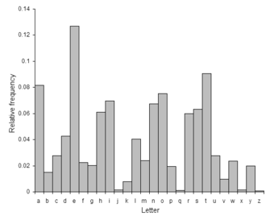
Index of Coincidence
Instead of discussing the formula…
Essentially, measuring whether a distribution of letters is “flat” or “rough”.
Think of a histogram. For English, the histogram looks “bumpy” or “rough”.
This is a sign that the underlying frequency of the letters hasn’t changed after encipherment.
(A simple classical cipher has been used.)
Source https://www3.nd.edu/~busiforc/handouts/cryptography/letterfrequencies.html

Slide 9
Back to scoring
For trying to solve a monoalphabetic cipher:
If we have a long enough text, we can try to assign the most popular letter in the ciphertext to “E”,
the second most popular to “T”, then “A” and so on. (ETAOIN)
If the ciphertext was as long as the corpus itself, this would work!
In general this would not work as the order of letter frequencies is very unlikely to match the general letter frequency of English.
But, the underlying pattern of distribution of PAIRS of letter persists after monoalphabetic substitution.

Slide 10
N=2 Case
TH 2.71
HE 2.33
IN 2.03
ER 1.78
AN 1.61
RE 1.41
ES 1.32
ON 1.32
ST 1.25
NT 1.17
EN 1.13
AT 1.12
ED 1.08
Percentage distribution – also very “rough”. If it were “flat” then each value here would be 100/(26*26) = 0.15%
Clearly some “bigrams” (i.e. sequences of length 2) occur far more often than “average”!

Slide 11
Scoring using bigrams
If we assume the plaintext language is (normal, plain) English
What is the probability that a given sequence of letters has come from (our corpus) or (English in general)
(hopefully the first reflects the second)
QUEENSLAND with bigrams (proportions)
QU 0.000964
UE 0.001140
EE 0.004278
EN 0.011330
NS 0.004927
SL 0.001148
LA 0.005360
AN 0.016136
ND 0.010683
Random text
MVLIIVQDOX
MV 0.0000315
VL 0.0000113
LI 0.0053863
II 0.0001404
IV 0.0021112
VQ 0.0000003 (nearly zero)
QD 0.0000020
DO 0.0030342
OX 0.0001503
Notes:
1 in 3 million bigrams are VQ – After Su Wan got off, the maglev quickly started up again

Slide 12
Scoring using bigrams
To get the probability that the complete sequence occurs, multiply all the probabilities together.
But on a computer we’d get a underflow if we did this, so work with the logarithms of the
probabilities, and add them (equivalent).
The higher our score is the more “likely” the sequence of letters is to be English.
“Log-likelihood”
QU 0.000964 -3.02
UE 0.00114 -2.94
EE 0.004278 -2.37
EN 0.01133 -1.95
NS 0.004927 -2.31
SL 0.001148 -2.94
LA 0.00536 -2.27
AN 0.016136 -1.79
ND 0.010683 -1.97
-21.56
MV 0.0000315 -4.50
VL 0.0000113 -4.95
LI 0.0053863 -2.27
II 0.0001404 -3.85
IV 0.0021112 -2.68
VQ 0.0000003 -6.52
QD 0.0000020 -5.70
DO 0.0030342 -2.52
OX 0.0001503 -3.82
-36.81

Slide 13
Search the Keyspace
So, we can now go exhaustively through all 26! (4 x 10²⁶) possibilities for the alphabet mapping …
Measure the score of each, and hopefully the mapping which gives us plaintext with the
highest sum is the correct one.
Or is there a better way?

Slide 14
Hill Climbing
One property of monoalphabetic ciphers is that a small change in the key only results in a small
change in the (plaintext/ciphertext).
So instead of doing an exhaustive search, we can:
Pseudocode
Load a table of frequency statistics
Iterate p times:
  Start with a random key
  Get the score for corresponding plaintext using the table
  Iterate q times:
    Pick two random letters from the key, swap them and score the result
    If the result is better, save this as new best solution, and go back to iii.
    Otherwise, at the end of the loop, go to i. (we couldn’t improve)

Slide 15
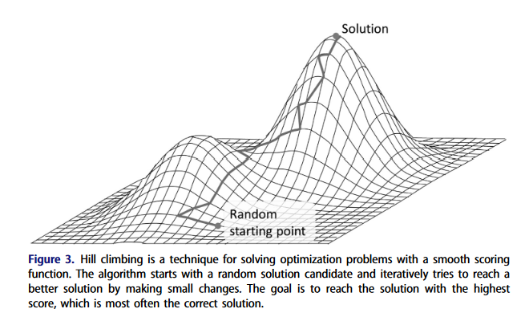
Hill Climbing
Source: Dunin, Ekhall, Hamidullin, Kopal, Lasry and Schmeh “How we set new world records in breaking Playfair
ciphertexts” (Cryptologia 2022) https://doi.org/10.1080/01611194.2021.1905734
Notes:
What could possibly go wrong?

Slide 16
Hill Climbing with N=2 bigrams
Example
CIPHERTEXT lisuangdnnsmdxvagscsqjngalcmloacsqkbasbhakstnglkhdcm 52 letters
-356.027140 vrewncoiccelisqnoeueaxconvulvjnueatfnefgntedcovtgiul qpntsbhwdoymragevixkclujfz
-337.508724 rvewncoiccelisqnoeueaxconrulrjnueatfnefgntedcortgiul qpntsbhwdoymragevlxkciujfz
-321.181284 rvewucoiccelisquoeneaxcournlrjuneatfuefgutedcortginl qpntsbhwdoymrcgevlxkaiujfz
-313.049954 rvewucoiccegisquoeneaxcourngrjuneatfueflutedcortling qpntsbmwdoyhrcgevlxkaiujfz
-308.691354 rvewucoiccegisquoeneaycourngrjuneatfueflutedcortling qpntsbmwdoyhrcgevlxkaiufjz
-305.304867 rvebucoiccegisquoeneaycourngrjuneatfueflutedcortling quntsbmwdoyhrcgevlxkaipfjz
-302.068723 rvebusoissegicquoeneaysourngrjuneatfueflutedsortling quxtsbmwdoyhrcgevlnkaipfjz
-297.626608 rvebusoissegichuoeneaysourngrjuneatfueflutedsortling quxtsbmvdoyhrcgewlnkaipfjz
…
-263.568108 alovethittodickehonoustheandagenourmeomperoftharpind lyxmatogdzvibcshrkjnquwfpe
-263.272106 alovethittodickehonoustheandabenourmeomperoftharpind loxmatygdzvibcshrkjnquwfpe
-262.973216 icowethattodalyehonourtheindivenousmeompesofthispand dzimatfglwexbcshyjknqoupvr
-262.942737 ayovethittodickehonougtheandalenourmeomseroftharsind lyxmatjgdrvobcsfpkhnquzeiw
-262.879948 alowethittodickehonougtheandavenourmeomseroftharsind lyxmatjgdzvibcsfwkhnqoupre
Notes:
-264.108

Slide 17
Hill Climbing with N=3 trigrams
Example
CIPHERTEXT lisuangdnnsmdxvagscsqjngalcmloacsqkbasbhakstnglkhdcm 52 letters
-567.533431 gmaxuezieeadipbuzahalwezughdgruhalckuakfucatezgcfihd svkmnhlcdrbqifyxzoetapjuwg
-516.394318 gmaxuenieeadipbunahalwenughdgruhalckuakfucatengcfihd svkmnhlcdrbqigyxzoetapjuwf
-488.860954 gmaxienueeadupbinahalwenighdgrihalckiakficatengcfuhd svkmnhlcarbqigyxzoetdpjuwf
-470.456983 gmaxienueeadupbinasalwenigsdgrisalckiakficatengcfusd svkmnhlearbqigyxzoctdpjuwf
-458.368725 omaxienueeadupbinasalweniosdorisalckiakficatenocfusd svkmnhyearbqiglxzoctdpjuwf
-436.115306 omaxiesueeadupbisanalwesiondorinalckiakficatesocfund svkmnhyearbqiclxzogtdpjuwf
…
-376.705055 igovethattocandehoroultheirciberouspeopmesofthismarc domvatiglpzjhxsbycknquewrf
-373.774702 igobethattocandehoroultheirciverouspeopmesofthismarc dumvatiglpzjhxsbycknqoewrf
-372.412431 igobethattodancehoroultheirdiverouspeopmesofthismard duvmatiglpzjhxsbycknqoewrf
-371.735917 imakethottagoudehanalytheingivenalsrearcesafthiscong sphvatmglruqicdyebknxofzjw
-368.435343 igovethattocambehonourtheincidenouspeoplesofthislanc dvmoatiglrehxcsbfjknquywpz
-366.836637 igovethattodambehonourtheindicenouspeoplesofthisland dvomatiglrehxcsbfjknquywpz
-366.056932 igovethattodaybehonourtheindicenouspeoplesofthisland dvomatiglrehpcsbfjknquywxz
-365.125617 imovethattodaybehonourtheindicenouspeoplesofthisland dvomatpglrehicsbfjknquywxz
-362.723077 icomethattodaybehorountheirdiverouspeoplesofthislard dvimatwglrehujsbfcknqopyxz
-361.510833 icomethattodaybehonourtheindivenouspeoplesofthisland dvimatwglrehucsbfjknqopyxz
Notes:
-366.197

Slide 18
Hill Climbing with N=6 Hexagrams
Example
CIPHERTEXT lisuangdnnsmdxvagscsqjngalcmloacsqkbasbhakstnglkhdcm 52 letters
-1054.885958 xcbryandaabedvhynbpbtwanyxpexiypbtqlyblsyqbuanxqsdpe nsidmeyvozfbwgrckuhqtxjlap
-1031.816685 xcbryandaabedwhynbpbtvanyxpexiypbtqlyblsyqbuanxqsdpe nsidmeyvozfbwgrckuhqtjxlap
-1013.566111 scbryandaabedwhynbpbtvanyspesiypbtqlyblxyqbuansqxdpe nsidmeyvozfbwgrckulqtjxhap
-988.668338 scbryandaabedwhynbpbtmanyspesiypbtqlyblxyqbuansqxdpe nsidmeyvozfbjgrckulqtwxhap
-957.162664 sciryandaaiedwhynipitmanyspesbypitqlyilxyqiuansqxdpe noidmeyvszfbjgrckulqtwxhap
…
-758.795995 iveformarredaycomenewprmoindigonewstoethoseurmishand dpvmsuohlzergcajwnkbtiqfxy
-758.284541 iveformarredaycomenewurmoindigonewstoethoseprmishand dpvmsuohlzergcatwnkbjiqfxy
-748.366734 iveformarredaycomeneturmoindigonetswoewhoseprmishand dpvmsuohlzergcatwnkqjibfxy
-736.193459 ahowestissodicketonougsteandayenourpeoplerofstarlind lpxmatjidzvhfcsbrkngqyueow
-721.203121 ahowestissodicketonougsteandamenourpeoplerofstarlind lpxmatjidzvhocsbrkngqyuefw
-709.104151 ibovethattowalkehonormtheinwidenorsueoucesofthiscanw dihoatpglwvxjcszfqknbumrye
-707.693943 ibovethattowalkehonoumtheinwidenousreorcesofthiscanw dihoatpglwvxjcszfbknqumrye
-690.879713 ibovethattowalkehoroumtheirwiderousneoncesofthiscarw dihoatpglwvxjbszfcknqumrye
-679.961424 ibovethattowalkehorouptheirwiderousneoncesofthiscarw dihoatpglwvxzbsjfcknqumrye
-676.234815 imovethattowalkehorouptheirwiderousneoncesofthiscarw dzhoatpglwvxibsjfcknqumrye
-664.673618 ijomethattodaybehonougtheindicenouspeoplesorthisland dvomafjgliwhucsbytknqpzexr
-648.893418 ijomethattodaybehonougtheindicenouspeoplesofthisland dvomatjgliwhucsbyfknqpzexr
-612.019228 ijomethattodaybehonourtheindicenouspeoplesofthisland dvomatfgliwhucsbyjknqpzexr
-598.271075 ijomethattodaybehonourtheindigenouspeoplesofthisland dvfmatogliwhucsbyjknqpzexr
-579.151794 icomethattodaybehonourtheindigenouspeoplesofthisland dvimatoglfwhucsbyjknqpzexr
Notes:
-586.511

Slide 19
How many Parameters? What were our inputs?
What’s under the bonnet of this car / algorithm?
Scoring input - textual corpus – Project Gutenberg (60,000 books, probably tens of gigabytes)
  Summarised (or possibly “compressed”) in our statistical table of n-grams!
Table built using n: length of n-grams (1 to 8)
Choices of iterations – when to stop each loop

Slide 20
Easy vs Complex ciphers
How can more complex ciphers be solved?
Is hill climbing going to be sufficient for all “classical” (pre-computer) ciphers?

Slide 21
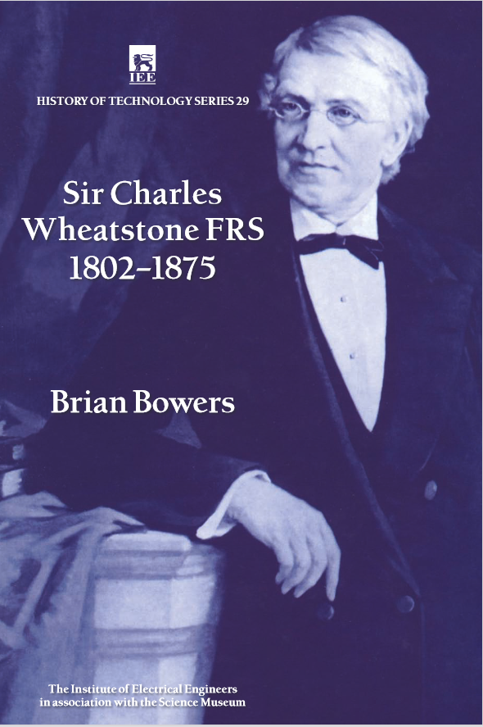
Playfair cipher
A matrix-based cipher invented by Charles Wheatstone in 1854
The original matrix was 3 rows, 9 columns with the 26 letters of English plus a question mark “?” – spaces are not used.
Intended to be used in the Crimean War (1853-1856).
Later used in Second Boer War (1899-1902), World War I (1914-1918) and World War II (1939-1945).
“Double Playfair” used in World War II by Germans; with two 5x5 matrices; at other times, use normal Playfair twice.

Slide 22
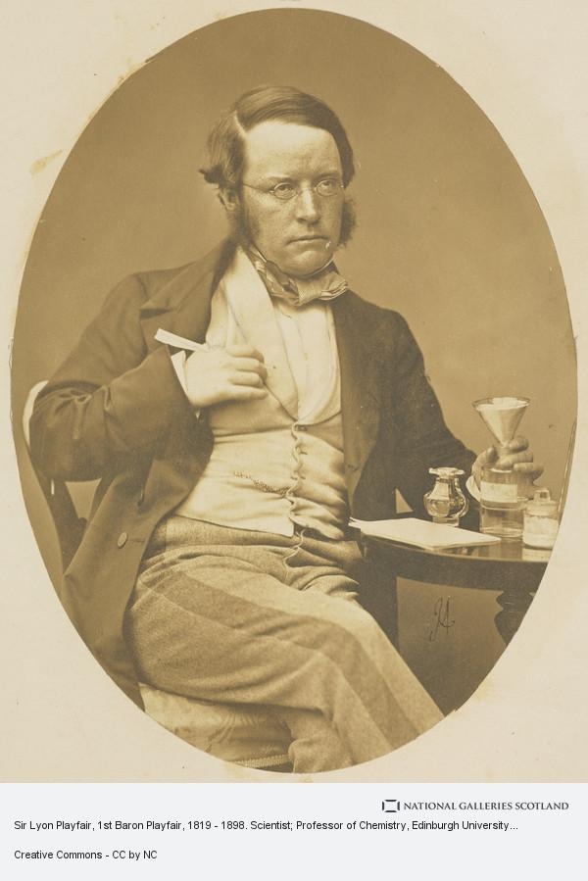
Playfair cipher
He presented it to the Foreign Office explaining that he could teach any school child how to use it in 15 minutes.
The response was “that may very well be so, but you could never teach it to an attaché!”
Since then, traditionally the cipher key has been presented in a 5x5 matrix form.
But the alphabet has 26 letters - we could either
Omit one letter – make sure that it is not used; something rare like a Q
Combine two letters – traditionally I/J or sometimes U/V (Roman alphabet has I/J or U/V equivalence)
source
https://www.nationalgalleries.org/art-and-artists/8957/sir-lyon-playfair-1st-baron-playfair-1819-1898-scientist-professor-chemistry-edinburgh-university

Slide 23
Playfair cipher
The Playfair cipher uses a 5x5 matrix and works on PAIRS of letters.
Again, traditionally based on a keyword (easier to remember!) e.g. “SURPRISE”
S | U | R | P | I/J
E | A | B | C | D
F | G | H | K | L
M | N | O | Q | T
V | W | X | Y | Z

Slide 24
Playfair cipher – Case 1 of 4
Two letters in same row, but different columns – SU – move one right - UR
S | U | R | P | I/J
E | A | B | C | D
F | G | H | K | L
M | N | O | Q | T
V | W | X | Y | Z

Slide 25
Playfair cipher – Case 2 of 4
Two letters in same column, but different rows – SE – move one down - EF
S | U | R | P | I/J
E | A | B | C | D
F | G | H | K | L
M | N | O | Q | T
V | W | X | Y | Z

Slide 26
Playfair cipher – Case 3 of 4
Two letters in different columns and different rows – SG – use diagonally opposite corners of imaginary rectangle – UF.
So for cryptanalysis, letters can never encipher to themselves (like the famous Enigma cipher of WW2) and there’s a symmetry for this case, SG goes to UF and vice versa.
S | U | R | P | I/J
E | A | B | C | D
F | G | H | K | L
M | N | O | Q | T
V | W | X | Y | Z

Slide 27
Playfair cipher – Case 4 of 4
Same letter twice – traditionally avoid this by inserting an X between the doubled letters.
Or, just pass through in plaintext (JFK in WW2) or go one down AND one right.
S | U | R | P | I/J
E | A | B | C | D
F | G | H | K | L
M | N | O | Q | T
V | W | X | Y | Z

Slide 28
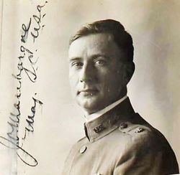
Playfair – The Weaknesses. Mauborgne (1914)
Some obvious weaknesses
Repeated plaintext pairs will map to repeated ciphertext pairs
A 2-gram frequency count may show what the most frequently
occurring 2-grams are (e.g. TH, HE, ON etc)
Most frequently occurring single letters are likely to be near the
most frequent English letters E, T, A, O in the square
If there are no repeated 2-grams these aren’t significant … key space
is of size 25! ~ 1.5 * 10²⁵
Joseph Mauborgne of US Army wrote about solving an 800-letter
Playfair cipher in 1914 (first recorded solution).
source
https://www.findagrave.com/memorial/7870655/joseph-oswald-mauborgne

Slide 29
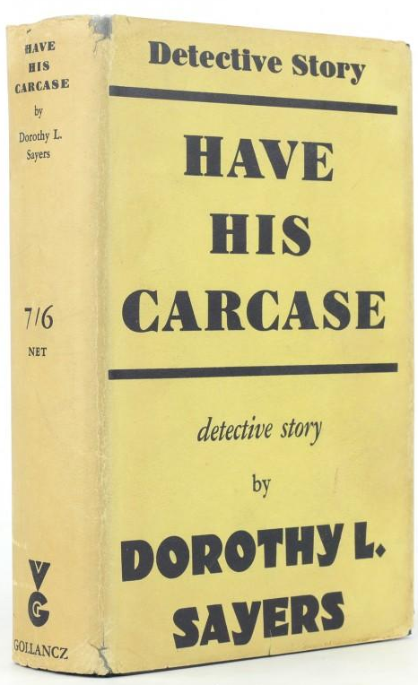
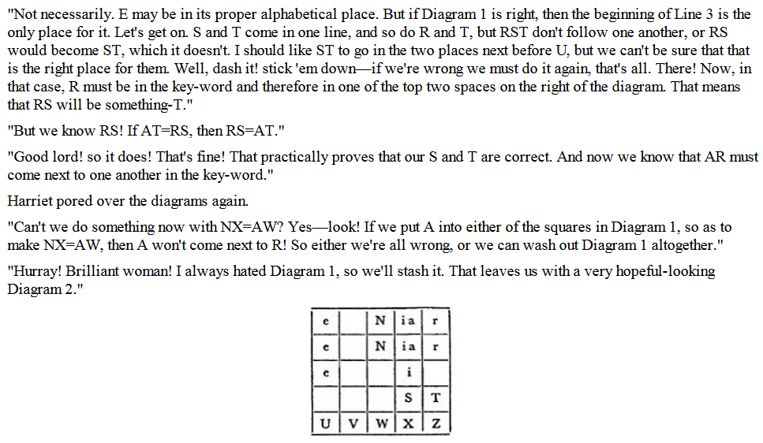
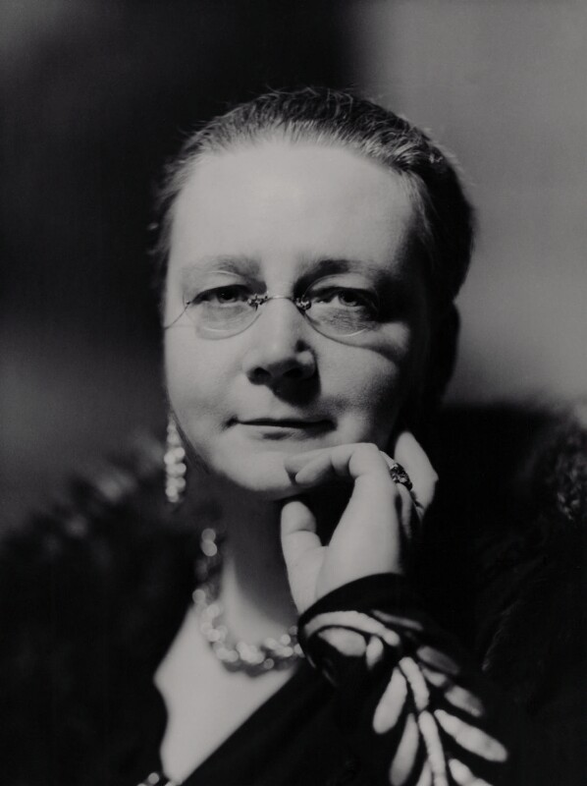
Playfair cipher – Dorothy L. Sayers (1932)
Dorothy L. Sayers’ 1932 novel “Have His Carcase” with Lord Peter Wimsey has an excellent description of cryptanalysis of the Playfair Cipher.
Source https://www.abebooks.com/servlet/ShopBasketPL?ac=a&il=S&ik=30609219326&cm_sp=svl-_-bdp-_-bsk
https://www.npg.org.uk/collections/search/portrait/mw165063/Dorothy-Sayers?LinkID=mp03987&role=sit&rNo=3
Notes:
Jules Verne “Journey to the Centre of the Earth”
DLS background in linguistics

Slide 30
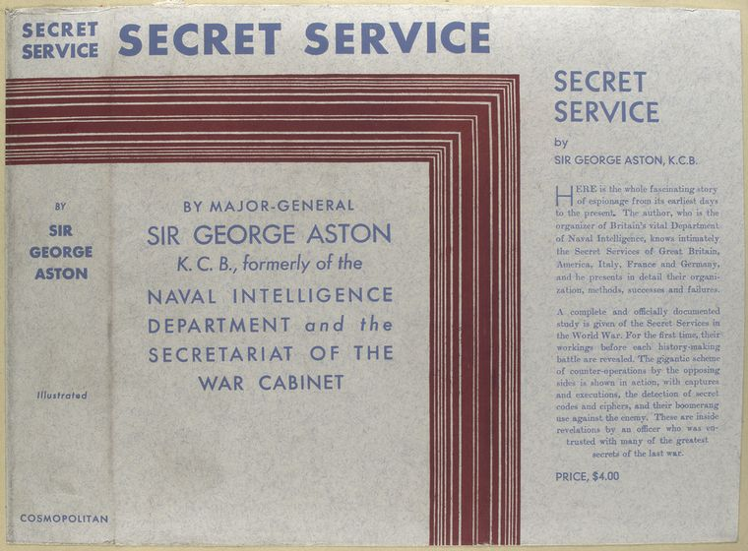
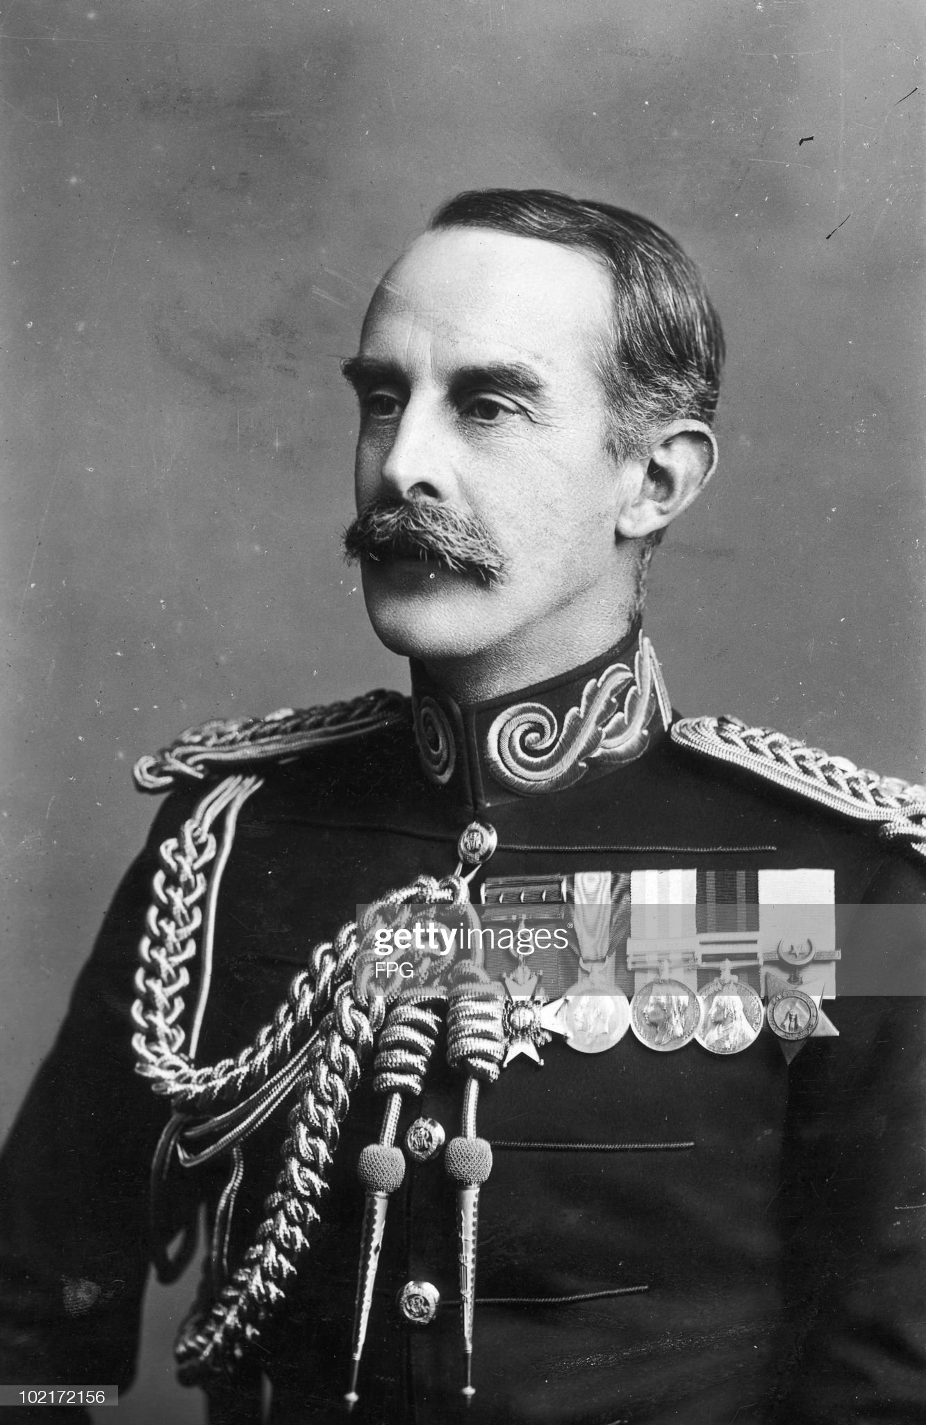
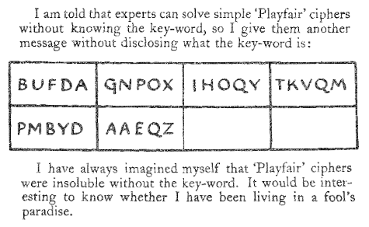
Playfair cipher – Sir George Aston (1933)
source
https://digitalcollections.nypl.org/items/510d47db-d35b-a3d9-e040-e00a18064a99
source https://www.tandfonline.com/doi/pdf/10.1080/0161-117891852983
source
https://www.gettyimages.co.uk/detail/news-photo/british-major-general-sir-george-aston-circa-1920-news-photo/102172156
Notes:
Espionage book

Slide 31
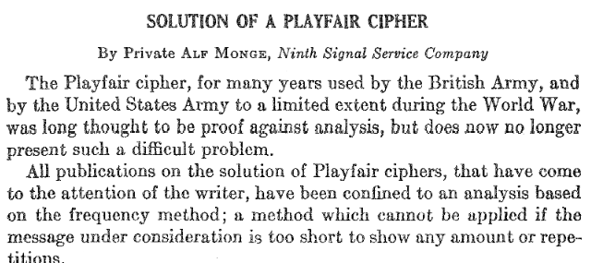
Playfair cipher – Alf Mongé
The author [William F. Friedman] once had a student who "specialized" in Playfair ciphers and became so adept that he could solve messages containing as few as 50-60 letters within 30 minutes. (1938, footnote to “Military Cryptanalysis” book)
Private Alf Mongé (1907-1978) – wrote a monograph in 1936 explaining how to solve Aston’s challenge.
A reasoning process which is difficult to replicate via a computer program.
But certainly based on probabilities of English words, beginnings, middles and ends of words.
source
https://www.nsa.gov/Portals/75/documents/news-
features/declassified-documents/friedman-documents/publications/FOLDER_205/41762559080174.pdf
Notes:
Obsessive

Slide 32
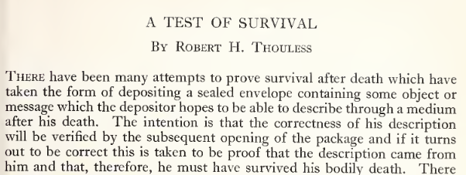
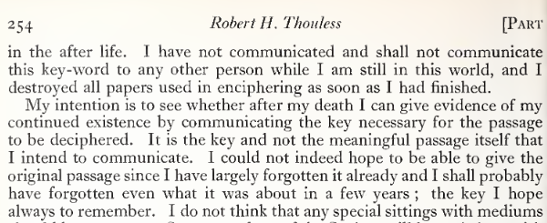
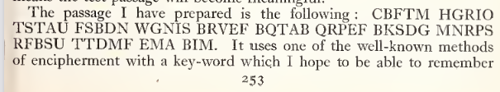
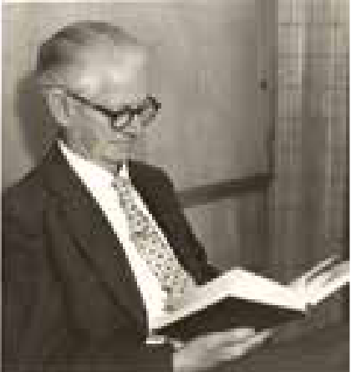
Playfair cipher – Thouless First Cipher (1948)
Cambridge Professor Robert H. Thouless (1894-1984, pictured, invented the “Psi” concept, son was Nobel physics prizewinner David Thouless) created a series of ciphers to test for the existence of life after death.
https://archive.org/details/proceedingsofsoc48soci
Source https://www.corpus.cam.ac.uk/sites/default/files/The_Record_No100.pdf

Slide 33
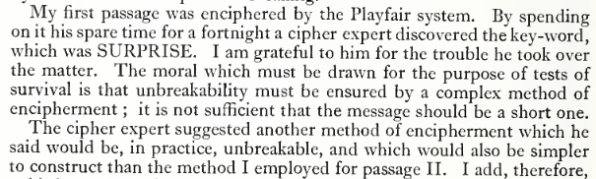
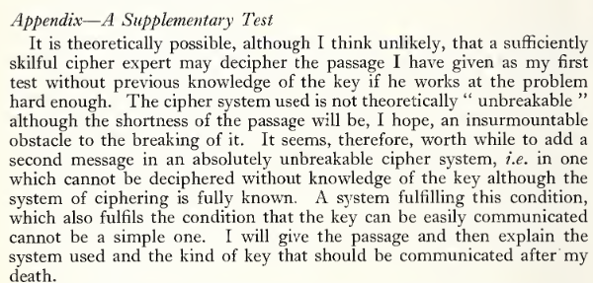
Playfair cipher – Thouless First Cipher (1948)
For his first cipher (July 1948) beginning CBFTM … he did not reveal the cipher type, but apparently a cryptanalytic expert was able to guess that as the message contained no J or doubled letters, that Playfair was used.
Remarkable achievement to solve a 66 letter Playfair cipher.
S | U | R | P | I/J
E | A | B | C | D
F | G | H | K | L
M | N | O | Q | T
V | W | X | Y | Z
https://archive.org/details/proceedingsofsoc48soci

Slide 34
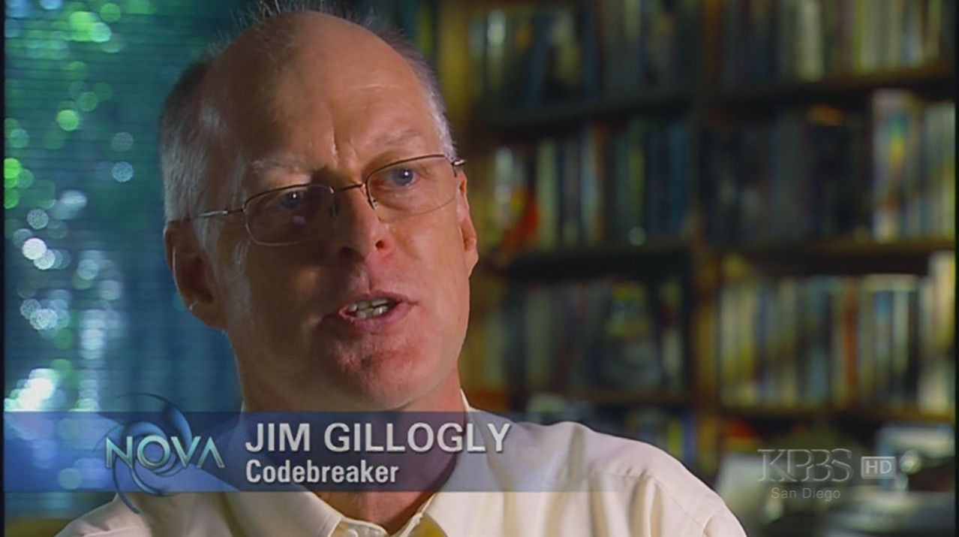
Playfair cipher – Thouless Second Cipher
For his next attempt in April 1949, he used “double Playfair” with two
keyword-based Playfair ciphers applied sequentially. 56 letter plaintext, letters added, 58 letter ciphertext.
Solved 1995 by Jim Gillogly, a Californian computer scientist. A dictionary attack …
Took about a month total (8.5 hours CPU time)
Ciphertext: BTYRR OOFLH KCDXK FWPCZ KTADR GFHKA HTYXO
ALZUP PYPVF AYMMF SDLR UVUB
Plaintext: THIS IS A CIPHER WHICH WILL NOT BE READ UNLESS I GIVE THE KEY WORDS
B | L | A | C | K
D | E | F | G | H
I/J | M | N | O | P
Q | R | S | T | U
V | W | X | Y | Z
B | E | A | U | T
Y | C | D | F | G
H | I/J | K | L | M
N | O | P | Q | R
S | V | W | X | Z
source https://www.latimes.com/archives/la-xpm-1995-11-05-me-65166-story.html
https://ciphermysteries.com/2018/11/18/usage-patterns-in-the-beale-ciphers

Slide 35
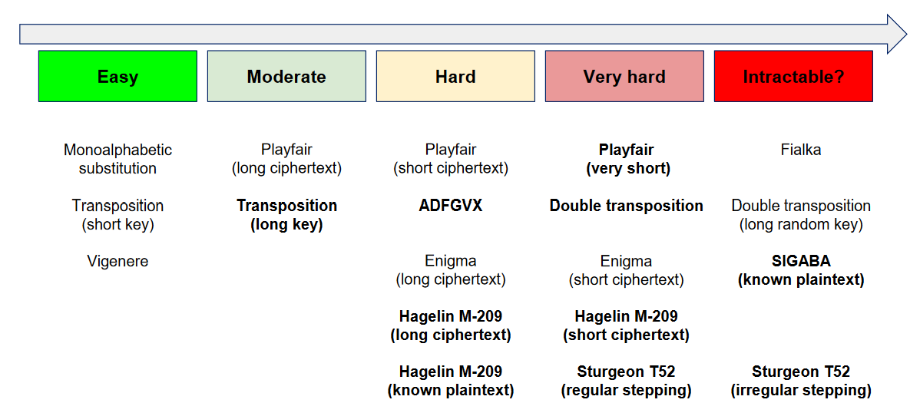
Playfair cipher – Difficulty level (Lasry)
Source
https://www.cryptool.org/assets/posts/2019-11-05-20-years-cryptool-looking-back-and-forward/CT20years_Modern_Cryptanalysis_of_Historical_Ciphers.pdf
Notes:
One of my co-authors George Lasry

Slide 36
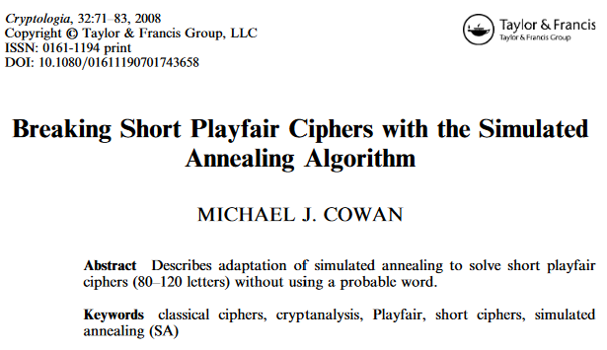
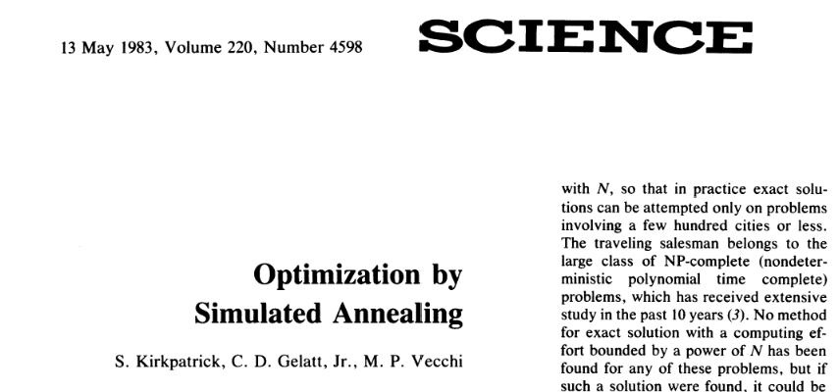
Playfair cipher – Hill Climbing / SA
Hill climbing can only solve Playfair ciphers of about 300 letters long with the “swap any two letters” technique.
In 2008, Michael Cowan (of the American Cryptogram Association) explained how to use simulated annealing to solve Playfair and other ciphers. The technique had originally been described in a 1983 paper.
source https://www.tandfonline.com/doi/pdf/10.1080/01611190701743658
source https://www.science.org/doi/10.1126/science.220.4598.671
Notes:
You won’t get stuck!

Slide 37
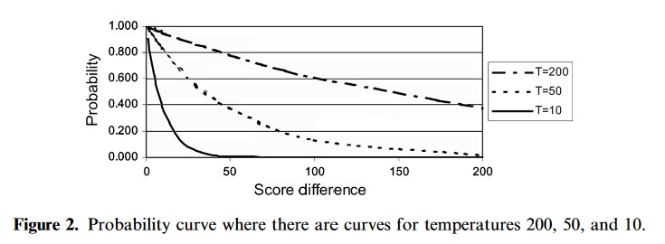
Playfair cipher – Hill Climbing / SA
Changes from hill-climbing algorithm.
Instead of always moving to a higher scoring key, sometimes we are allowed to move to a lower scoring key based on a variable called the temperature.
(the temperature can be kept constant or decrease over time)
The probability of allowing a move to a worse key is based on e^{-d/T} where d is the change in the score and T is the current temperature.
source https://www.tandfonline.com/doi/pdf/10.1080/01611190701743658
Notes:
You won’t get stuck!

Slide 38
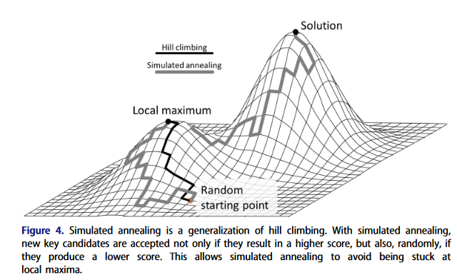
Simulated Annealing
Source: Dunin, Ekhall, Hamidullin, Kopal, Lasry and Schmeh “How we set new world records in breaking Playfair
ciphertexts” (Cryptologia 2022) https://doi.org/10.1080/01611194.2021.1905734

Slide 39
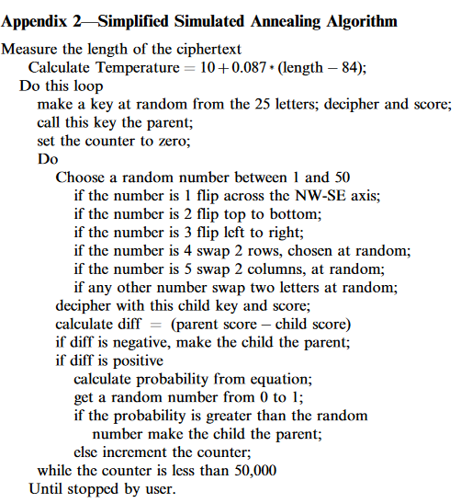
Simulated Annealing – Cowan’s Algorithm
source Cowan (2008)
https://doi.org/10.1080/01611190701743658

Slide 40
Simulated Annealing vs Hill Climbing
Simulated annealing has extra parameters compared to hill climbing.
Like hyperparameter tuning in regression (machine learning)
Linear regression
Random forest (mtry and trees)
Gradient boosting machines (even more parameters)
No Free Lunch. You might possibly improve your regression, but you’ll spend some time tuning your parameters.
https://en.wikipedia.org/wiki/No_free_lunch_theorem

Slide 41
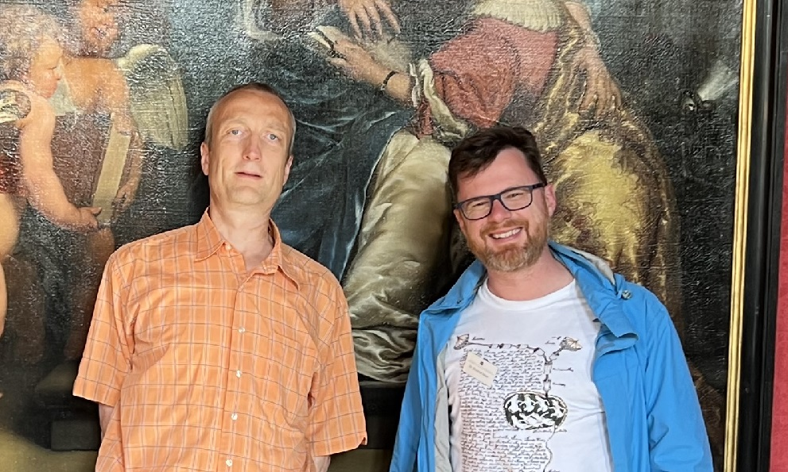
Playfair cipher – Klaus Schmeh challenge
Cipherbrain blog of Klaus Schmeh
We know the best-ever human solver (Alf Monge) can solve 50-60 letter challenges in about half an hour and on occasion (special cases) even a 30-letter challenge.
Klaus Schmeh started a challenge in 2018
What is the shortest Playfair cipher (in English) with a random matrix that can be solved?
Traditional rules i.e I/J combined, doubled letters split with an X
(Obviously with a dictionary keyword based matrix we can search through the whole dictionary)
source
https://scienceblogs.de/klausis-krypto-kolumne/files/2022/06/Schmeh-Bean.jpg

Slide 42
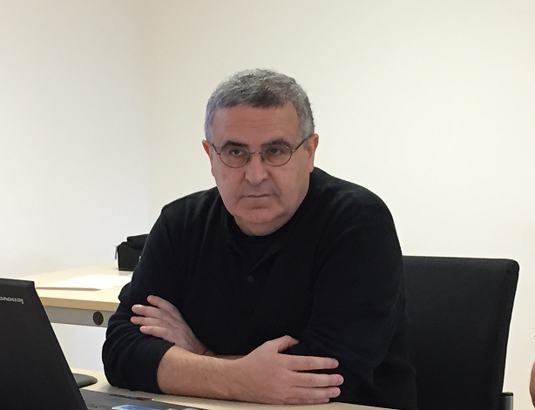
Playfair cipher – 50 letter challenge
50 letter challenge: 7 April 2018
George Lasry (a co-author, pictured, Ph.D. Kassel University 2018)
MQVSKPEVISBAWKTPKPPNAUNUNEGLUZTYUZLYGCTZKNKUSTAGCTNQ
WHILEINPARISIRECEIVEDORDERSTOREPORTXTOGENERALFOSTERX
source
https://scienceblogs.de/klausis-krypto-kolumne/2018/04/07/playfair-cipher-is-it-unbreakable-if-the-message-has-only-50-letters/

Slide 43
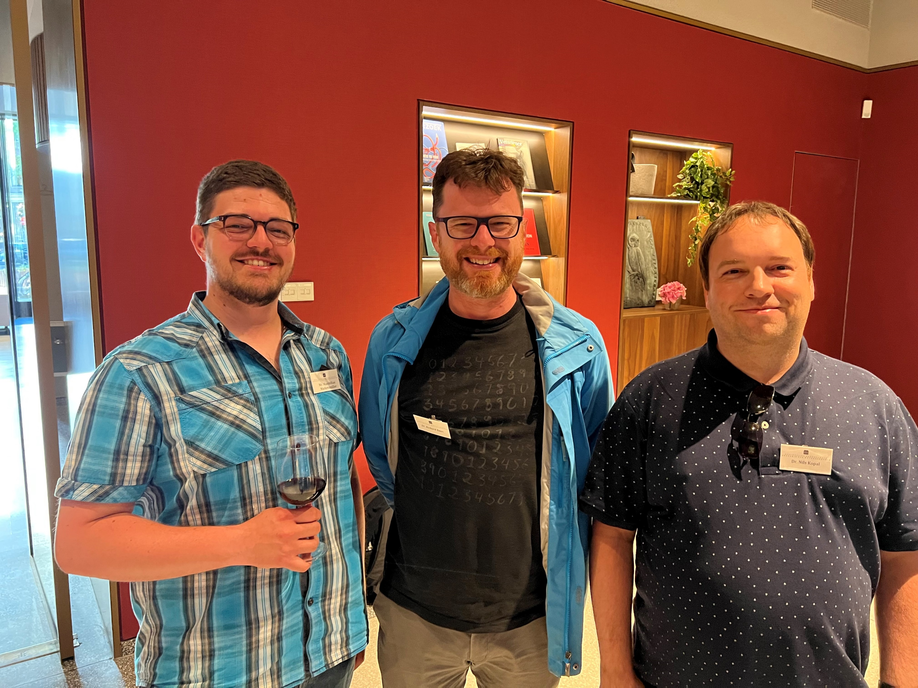
Playfair cipher – 40 letter challenge
8 December 2018
Nils Kopal (University of Siegen)
OFFCERVUMWMOOMRUFIWCMAOGFVZYFXYBHGUXZVEH
MEETYOUTOMORROWATFOURTWENTYATMARKETPLACE
https://scienceblogs.de/klausis-krypto-kolumne/2018/12/08/playfair-cipher-is-it-breakable-if-the-message-has-only-40-letters/

Slide 44
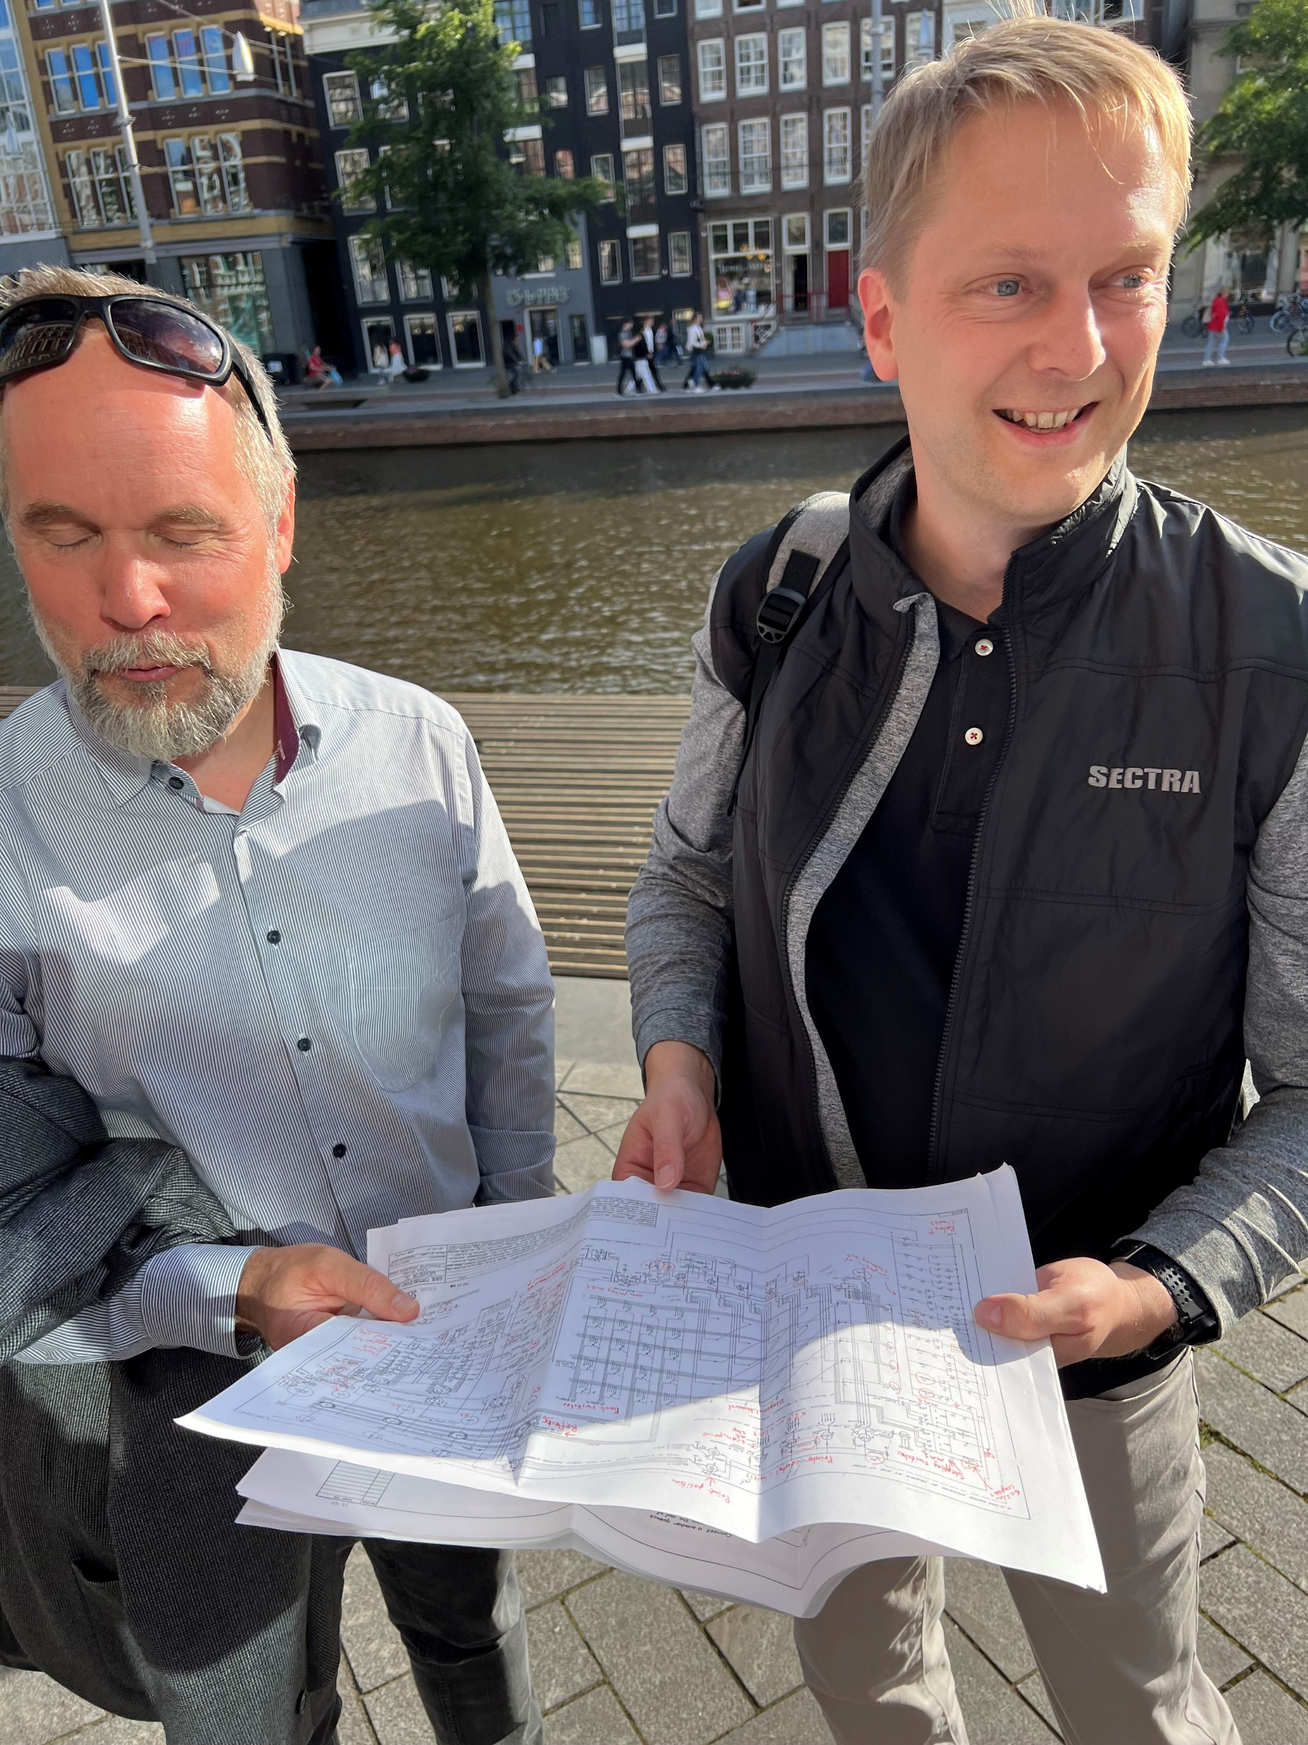
Playfair cipher – 30 and 28 letters
30-letter challenge: 15 April 2019
Solved 3 September 2019 by Magnus Ekhall
SXCREDBQUGVZRSMNDSIKRKWRSGNSNXVM
TAKETHELASTXTRAINTOYORKONSUNDAYX
Simulated annealing with “tabu search”, 5-grams
28-letter challenge: 10 September 2019
Solved 11 November 2019 by Magnus Ekhall
ZXLSEWHCHUCELQOEPNYRIWYCVQLS
STAYWHEREYOUAREUNTILTHURSDAY
Basis: simulated annealing, 6-grams, Aho-Corasick algorithm, but manual intervention needed
https://scienceblogs.de/klausis-krypto-kolumne/2019/04/15/playfair-cipher-is-it-breakable-if-the-message-has-only-30-letters/?all=1
https://scienceblogs.de/klausis-krypto-kolumne/2019/09/05/magnus-ekhall-solves-playfair-challenge-and-sets-a-new-world-record/
https://scienceblogs.de/klausis-krypto-kolumne/2019/09/10/can-you-solve-this-playfair-cryptogram-and-set-a-new-world-record/?all=1
https://scienceblogs.de/klausis-krypto-kolumne/2019/11/14/magnus-ekhall-solves-28-letter-playfair-challenge-and-sets-new-world-record/
Magnus in Amsterdam June 2022
Holding US WW2 Bombe plans
Notes:
Lots of manual sifting needed

Slide 45
Playfair cipher – 26 letters
26-letter challenge: 22 November 2019
DBAQIHKNRWVBKWNADQWRAMOQIY
WAITFORFURTHERINSTRUCTIONS
Solved 17 December 2019 by Konstantin Hamidullin
Using n-gram statistics for words, building solution from left to right with guided search
https://scienceblogs.de/klausis-krypto-kolumne/2019/11/22/can-you-solve-this-playfair-cryptogram-and-set-a-new-world-record-2/
https://scienceblogs.de/klausis-krypto-kolumne/2019/12/21/konstantin-hamidullin-solves-26-letter-playfair-challenge-and-sets-new-world-record/

Slide 46
Playfair cipher – unsolved challenges 24/22 letters
24-letter challenge VYRSTKSVSDQLARMWTLRZNVUC (27 January 2020)
22-letter challenge NTKRKDLDGHISZWLICKHIAO (13 August 2021) solution may not be unique
Possible 24-letter solutions given by Konstantin Hamidullin (“farmerjohn”):
and perhaps he’s collecting
they say the liquor had gone
the name of springtime leaf
he counted companion boats
you’re confusing dark grapes
dear me did not fall heavily
Basil has a very short space
he counted companion goats
you’ve met the pointed boots
I came to an English diabolo
I do wish those forms of wine
say nothing but a form advice
source https://scienceblogs.de/klausis-krypto-kolumne/2020/01/27/can-you-solve-this-playfair-cryptogram-and-set-a-new-world-record-3/
https://doi.org/10.1080/01611194.2021.1905734
Notes:
Odd sounding

Slide 47
Thank You
Contact information
R.Bean1@uq.edu.au

